Slide 1

Get Help App
Design Defence
By Team Starneo

Slide 2
Introduction
High Level View
Graphic Design of The App
Software & Database Design of the App
Conclusion

Slide 3
High level Design
How is the app going to function?
Why was is it changed to the current design?
Was the Client interaction impactful ?

Slide 4
Design Requirements
How much did the requirements change?
What are the main technologies that will be utilised ?
Has accessibility been taken in consideration ?

Slide 5
Development Methods
What do we think so far about Agile methodology ?
How much did the interaction with the client affect the process of development thus far?

Slide 6
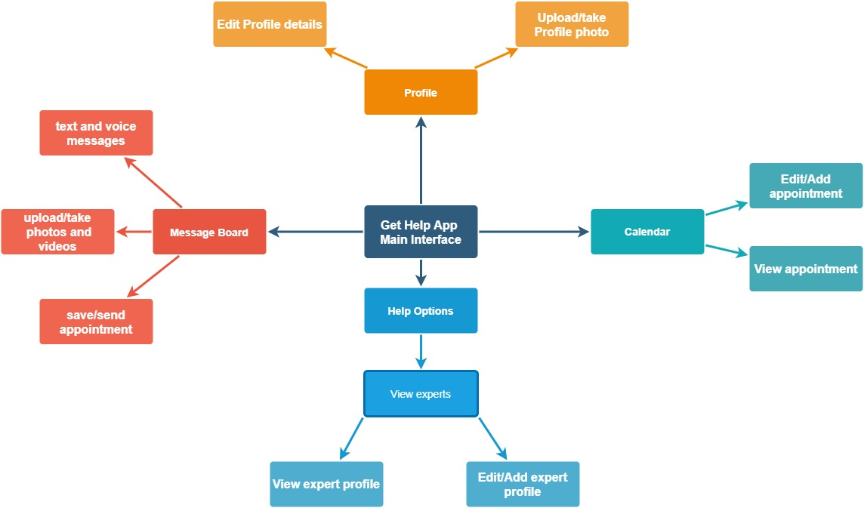
App XML Map Design

Slide 7
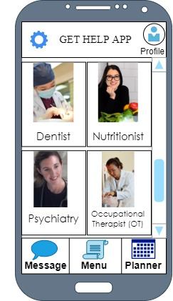
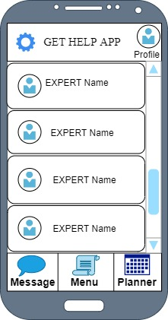
Prototype Design

Slide 8
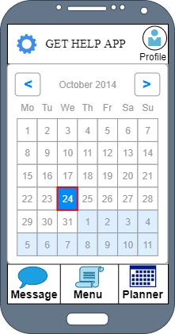
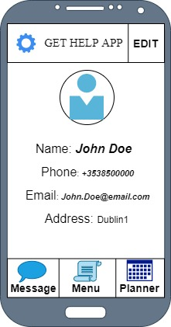
Prototype Design

Slide 9
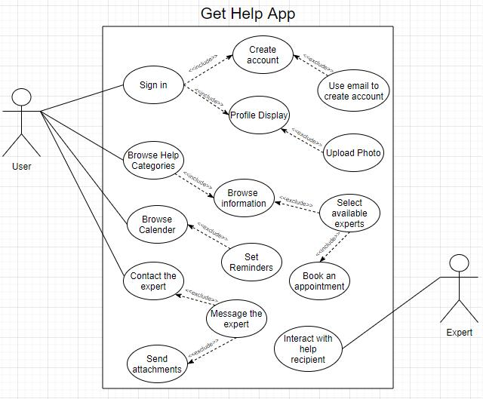
Use Case Diagram

Slide 10
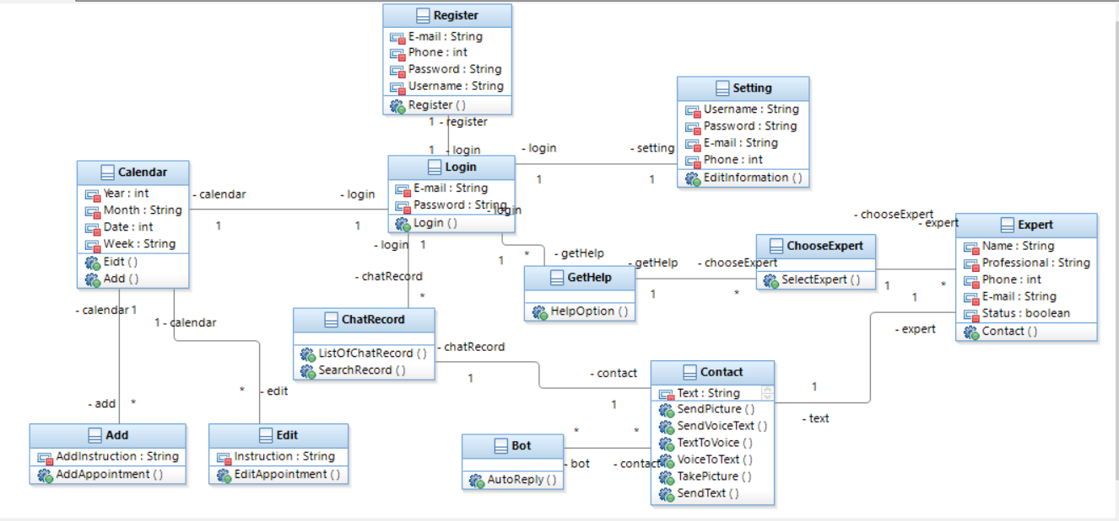
Class Diagram

Slide 11
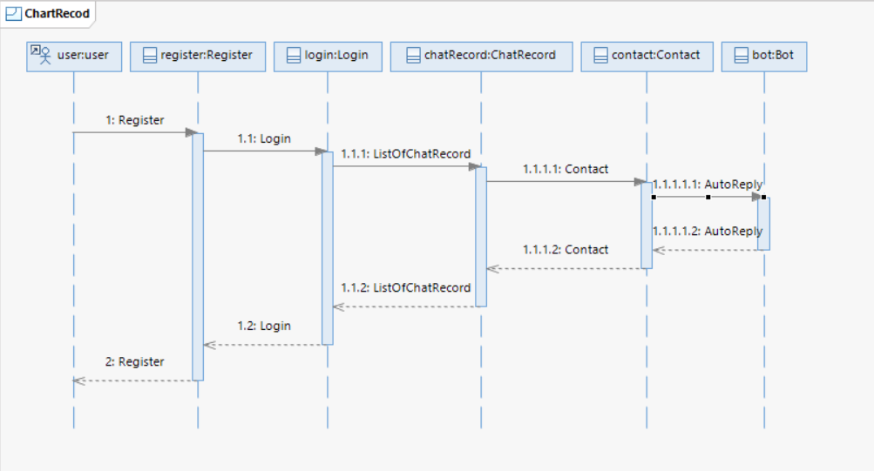
Sequence Diagram

Slide 12
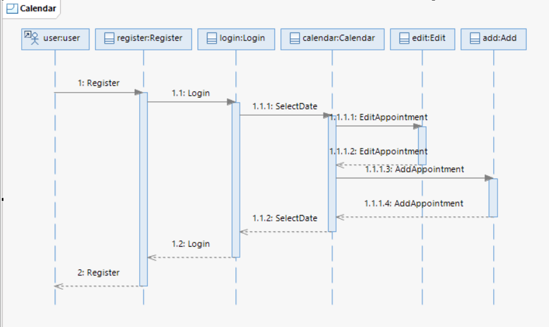
Sequence Diagram

Slide 13
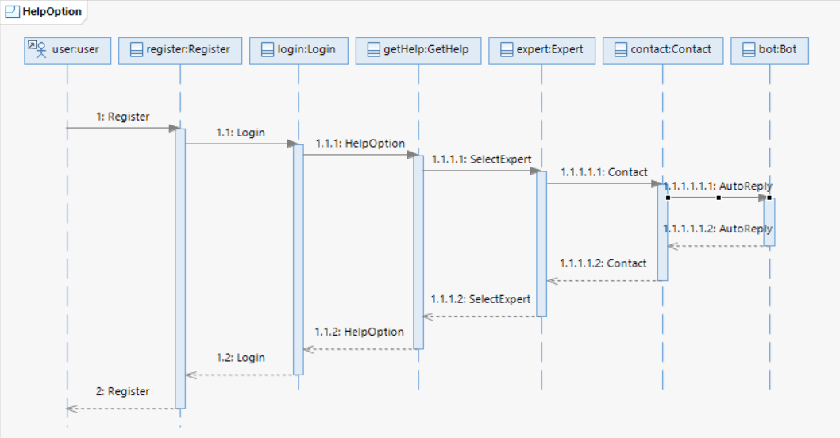
Sequence Diagram

Slide 14
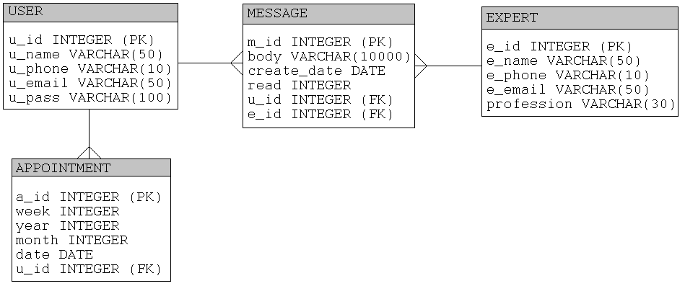
Database Design

Slide 15
Conclusion
What do we think about the project so far?
Are we Satisfied with the current design ?
Where are we going with this?

Slide 16

Q & A

Slide 17
Thank You! That’s All Folk! ☺

